Slide 1
Exploring Efficient Architectures for LLMs
Department: Theory Lab, Huawei Hong Kong Research Center
Author: Wenqi ZENG
Date: 18/11
Security Level:
Notes:
Hello everyone, it is very honored to invited by prof.Yao to give a presentation on our recent research. Today about literature review on exploring efficient architechtures for llms, a brief self introduction, I am a researcher in the Theory Lab at the Hong Kong Research Center, Huawei. I received my Ph.D. in Mathematics from the Hong Kong University of Science and Technology, supervised by Prof. Yuan YAO. My research interests focus on AI for science, with a specific focus on molecular dynamical systems and language models. Today I want to share the Exploring Efficient Architectures for LLMs
. This sharing won’t involve too many specific details, mainly just a high-level and general overview.

Slide 2
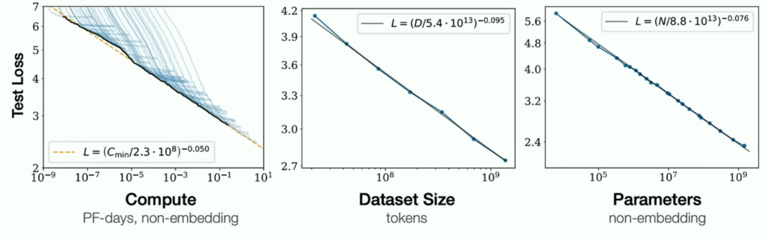
The age of Pre-Training LLMs
Autoregressive models trained on text, big network, big datasets
GPT-2 [Radford et al., 2019]
GPT-3 [Brown et al., 2020]
Scaling laws [Kaplan et al., 2020]
https://www.youtube.com/watch?v=1yvBqasHLZs
Notes:
We are in the age of llm. When comes to the training for llm, actually, a lot of people thought there was no need to change the architecture of foundation models. Everyone focused more on data, thinking it was way more important than architecture. Because back when we were just piling on compute resources and data, the Scaling Law hadn't hit a wall yet. In that situation, big companies had no incentive to research new architectures; they just made models stronger by increasing compute and data scale. So, for a long time, many people believed architecture wasn't that important and that data was the key . If we have a large big dataset, we train a very big neural network, then the success is guaranteed

Slide 3
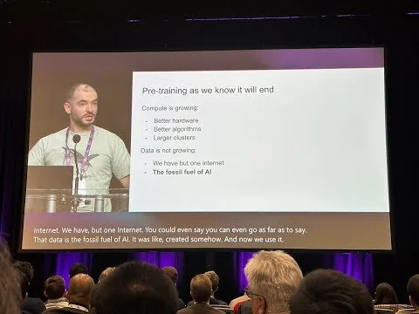
Why we need new Architecture for LLM
Training Scaling Hits a Wall
Marginal returns from data and compute are diminishing.
Test-Time Scaling Emerges
Amplifies the Transformer's core efficiency problems.
The Need for New Architectures
Must solve both training and test-time challenges simultaneously
https://www.youtube.com/watch?v=1yvBqasHLZs
Notes:
But now things are a bit different. For instance, Ilya, who you’re probably familiar with, mentioned in a keynote last year that he thinks pre-training has hit a wall.
The main scaling direction now is actually Test Time Scaling, like with DeepSeek-R1, which uses a very long chain of thought. In this scenario, we have extremaly long sequence during test time. the efficiency issues of Transformers on long text get amplified even further. So, given this background, research on new architectures is becoming increasingly important.

Slide 4
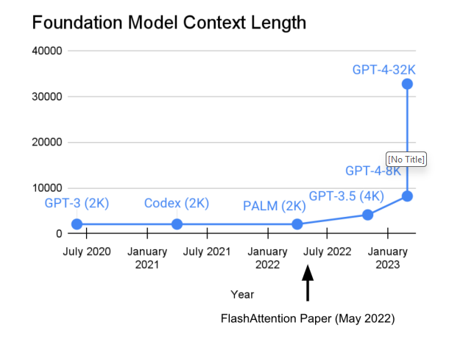
Why we need new Architecture for LLM
Training Scaling Hits a Wall
Marginal returns from data and compute are diminishing.
Test-Time Scaling Emerges
Amplifies the Transformer's core efficiency problems.
The Need for New Architectures
Must solve both training and test-time challenges simultaneously
https://www.youtube.com/watch?v=1yvBqasHLZs
Notes:
And we have a figure showing context length grow rapidly, 32k for gpt 4.
Researching new architectures might not only improve efficiency for Test Time Scaling, but also may have more possibilities for Training Time Scaling.
For example, if we’re seeing decreasing returns from data and compute resources now, it might actually be because the architecture itself has hit a bottleneck.
If we design some more expressive architectures, could that further boost model performance? This is actually a question really worth exploring.
So, heres introduces several reasons why we need a new architechture.

Slide 5
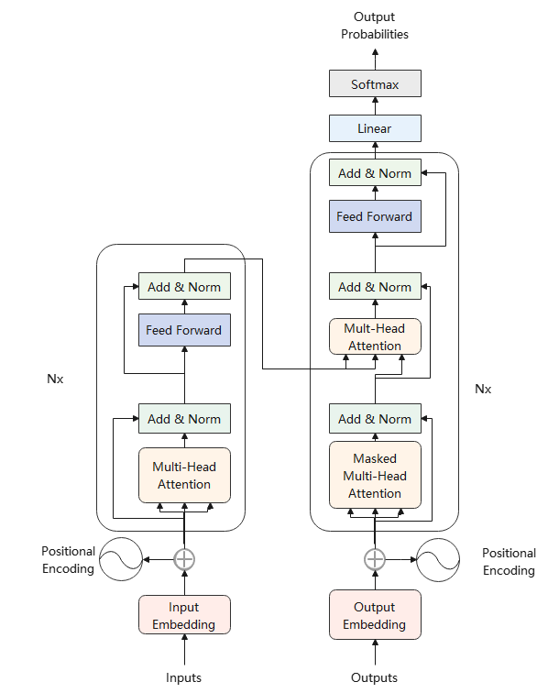
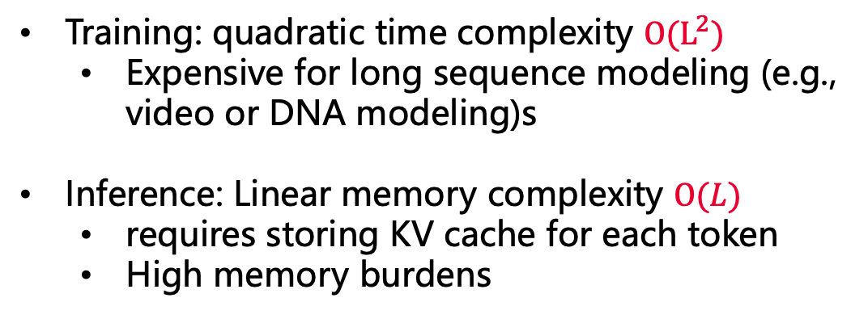
Behind LLM: Transformer Architecture
Training: quadratic time complexity $O(L^{2})$
Expensive for long sequence modeling (e.g., video or DNA modeling)s
Inference: Linear memory complexity $O(L)$
requires storing KV cache for each token
High memory burdens
Notes:
Now we might get to be a littledetails about transformers. Remember we referred in last page, how the context length grows rapidly. The reason we care abou context length, is that the complexity of both training and inference. You might know that the cot, chain of thought, react for llm agent, is a very useful way to boost the performance during the inference, but it will also bring a lot of tokens as a price. So the o(L) complexity during inference now seems high.
Lets go some further details, about the complexity of training and testing.

Slide 6
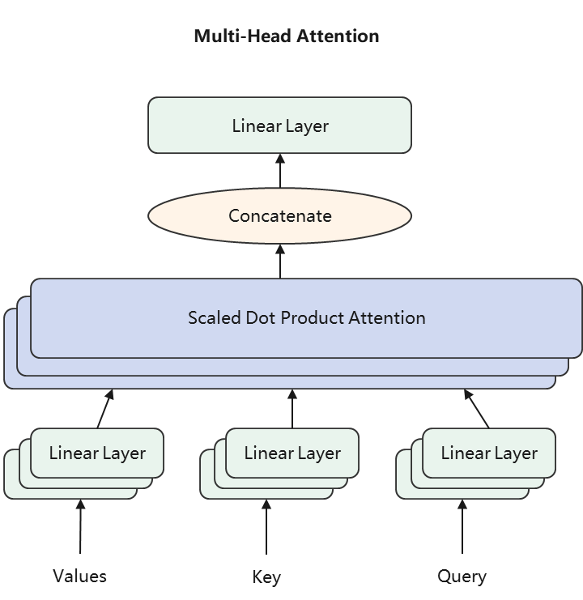
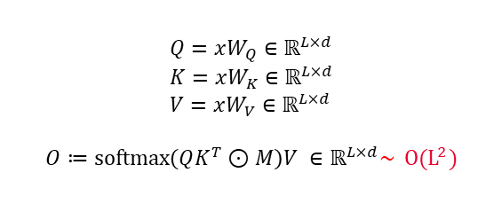
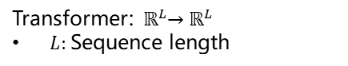
Behind LLM: Transformer Architecture
time complexity mainly comes from dot-product softmax attention
Transformer Architecture
Multi-Head Attention Architecture
Dot-Product Attention Architecture
MatMul
SoftMax
Mask(Opt.)
Scale
MatMul
Q
K
V
$$Q=xW_{Q}∈ℝ^{L×d} \\ K=xW_{K}∈ℝ^{L×d} \\ V=xW_{V}∈ℝ^{L×d}$$
$$O≔softmax\left(QK^{T}⊙M\right)V ∈ℝ^{L×d}\sim O(L^{2})$$
Transformer: ${ ℝ}^{L}→ℝ^{L}$
$L:$Sequence length
Notes:
For example, we have the sequence with l as it length as input, the core block is the multihea attenytion block. Inside the moltihead attention, for our input x, we have query, key, value projection. The QK transpose, is a matrix multiplication, with matrix shape (L by d) and it has complexity of O(L^2).
But when inference, we can save the K,V, which is know as KV cache, and is an common practice nowadays. With extra space cost for KV, we have reduced time complexity, O(L).
And todays talk will be concentrated on, what efficient variants we have for the attention machenisms.

Slide 7
Outline – Efficient Attention Variants
Linear Attention Machenism
Data-dependent decay: RetNet, LighteningAttention, Mamba2, GLA
Test time online learning: DeltaNet, Test-Time-Training, Titans, RWKV7, Gated DeltaNet
Sparse Attention Mechanisms
Static Sparsity: BigBird, StreamingLLM, H2O
Dynamic Sparsity: Native Sparse Attention (DeepSeek), MoBA (Kimi)
Hybrid Attention Mechanisms
Inter-layer mixing: Minimax-01, Jamba, Samba
Intra-layer mixing: Hymba
Notes:
In total we have three kinds of attention machenism, linear, sparse, and hybrid.
Take linear attention, for example. It can basically be split into a few categories. First, there are models with decay rates, like RetNet from MSR. Then there’s Lightning Attention, which is the attention mechanism used in MiniMax-01. And like Mamba-2, it’s actually just linear attention with an added dynamic decay. As for Gating Linear Attention, that’s work from MIT group, and it’s also a type of linear attention with dynamic decay. Another kind that’s become popular recently is Test-time online learning linear attention. Methods like DeltaNet, Test-time Training, and Titans are quite trendy right now. You’ve probably seen the paper pop up a lot recently on social media or WeChat. And then things like RWKV-7 and Gated DeltaNet are variants of online learning linear attention that have even stronger expressive power.
Then besides linear attention, there’s also something called sparse attention. Sparse attention is generally divided into static sparse and dynamic sparse
beyond these two methods, we also encounter what are called hybrid attention models, which can mainly be divided into two categories. One is mixing between layers, and the other is mixing within layers

Slide 8
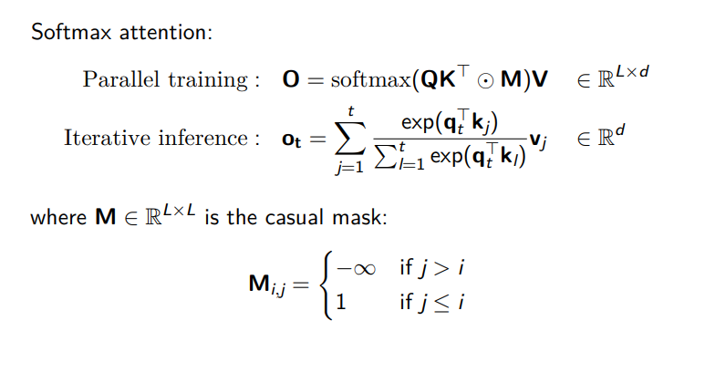
1.1 Linear Attention : From standard attention
Linear Attention = Standard attention - softmax
Notes:
First, we begin by some background knowledge for linear attention. that how linear attention is transformed from standard softmax attention, recall that we have Q K V from transformer attention, nowadays we are only using decoder, with low trangular values in the attention matrix, so we have a causal mask. Also here we have a iterative recurrence form, showing for the inference.

Slide 9
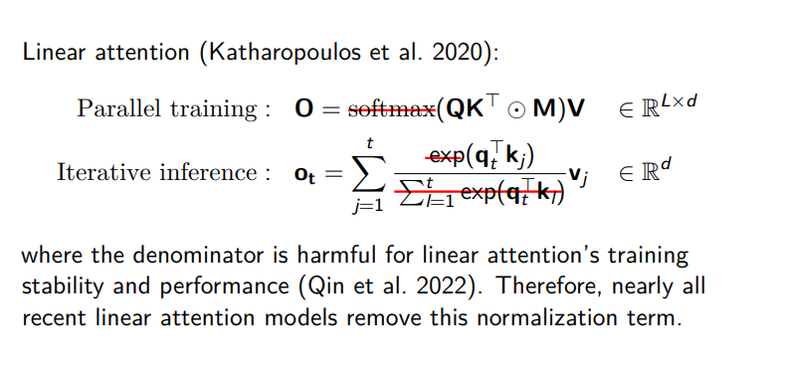
1.1 Linear Attention : From standard attention
Linear Attention = Standard attention - softmaxs
Notes:
The current linear attention directly removed the sofamax, and the denominator. This looks simple and too brutal force. actually around 2020, there are some quite complicate linear attention like Performer, and use complicate kernel functions to approximate softmax. However, these complicated linear attention models are hard to scale up to large models. So nowadays, especially in the works that I am going to refer in today’s talk, they show it is enough to directly remove and drop the softmax.
Removing softmax didn't actually lower the complexity, but it gave us convenient linearity, which allows us to use chunkwise optimization to speed up training. As for removing normalization, reference [1] proves that getting rid of the normalization term helps with the training stability and task performance of linear attention. Because of this, mainstream linear models nowadays have basically all removed that term.

Slide 10
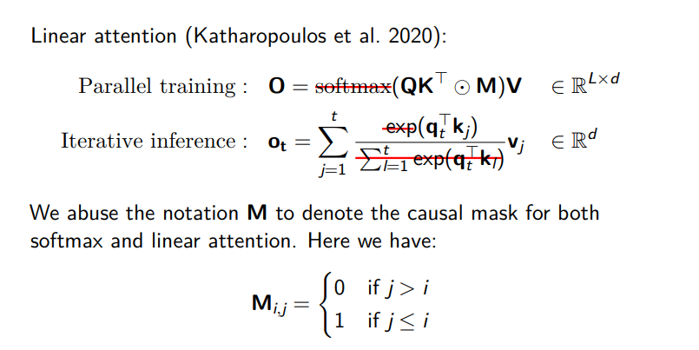
1.1 Linear Attention : From standard attention
Linear Attention = Standard attention - softmax
Notes:
Here for the notation simplicity, we abuse the notation M. And from the iterative inference, in next part, we will show how the iterative inference is related to RNN.

Slide 11
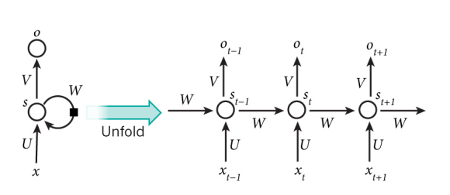
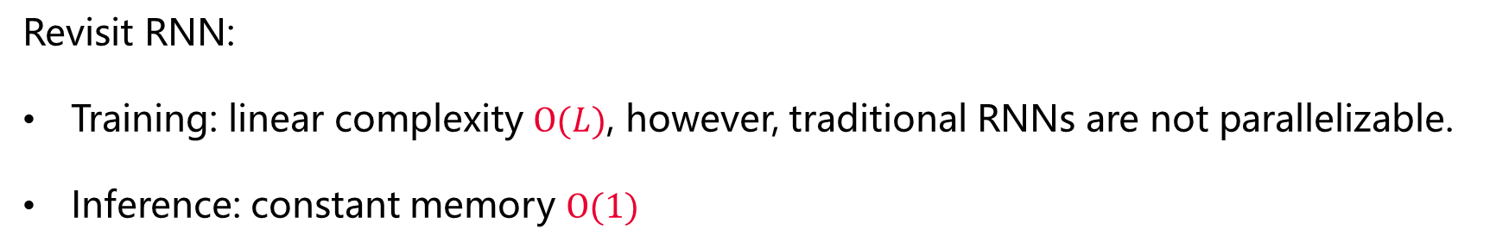
1.2 Linear Attention: From RNN view
Revisit RNN:
Training: linear complexity $O(L)$, however, traditional RNNs are not parallelizable.
Inference: constant memory $O(1)$
Notes:
Recall from last slide, we have the linear attention from standard softmax attention, and you may notice that the form of linear attention can be rewritten as recurrent form, so in this section, we will show how linear attention is related to RNNs, to show linear attention is actually linear RNN but with matrix value hidden states. The benefits of RNN lies in the the complexity, especillay in the inference, a constant complexity. And the one main draw back is that the training of RNN is not parallelizavble. The linear attenytion models will fix this drawback.

Slide 12
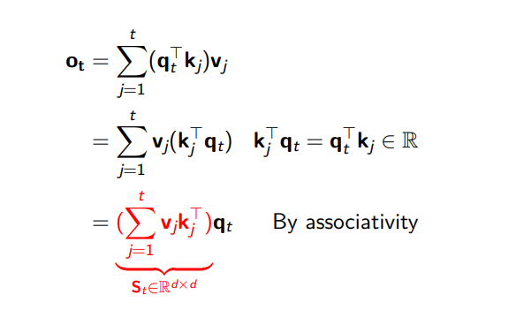
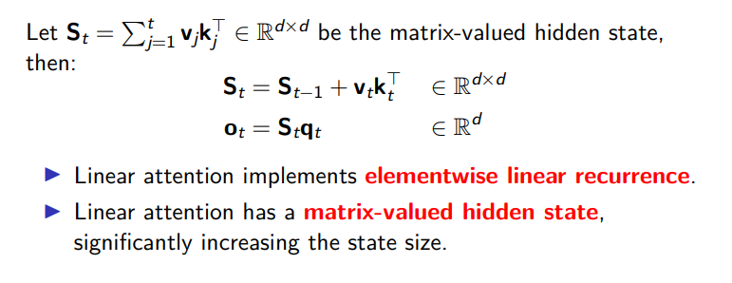
1.2 Linear Attention: From RNN view
Linear Attention = Linear RNN + matrix-valued hidden states
Notes:
In RNN view: element wise
From the iterative inference from, we have ot equalis to a linear composition of qkv, and by associaty, we have the vk related to sum over j, and q related to t. the new capital S, is a matrix hidden state. So for the new updating rule,
▶ Linear attention implements elementwise linear recurrence.
▶ Linear attention has a matrix-valued hidden state, compare to RNN with vector hidden states, significantly increasing the state size.
Linear Attention = Linear RNN + matrix-valued hidden states
It updates the state using some efficient operations, like the outer product, and since the outer product has a lot of nice properties, it makes training on hardware extremely efficient. Buut for hardwares and engineers, I won’t go into the specific details here

Slide 13
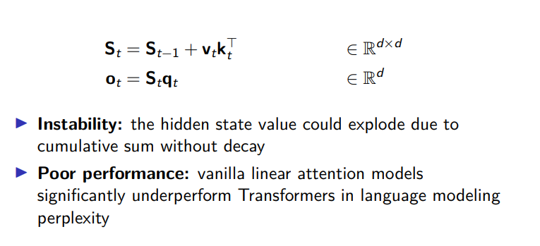
1.3 Challenges in Linear Attention: Instability
Notes:
We have went through the background of linear attention. However, due to the simplicity, it faces some challenges to acheieve same performance as transfotrmer.
The issue comes from two ways, there is no decay on the S
$S_{t}$Without a forgetting mechanism, numerical values can easily explode [2]
$S_{t}$ lacks In-context retrieval capability

Slide 14
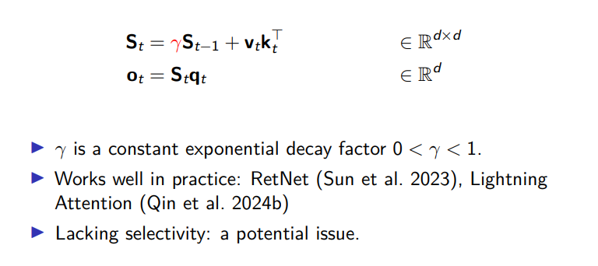
1.3 Challenges in Linear Attention: Instability
A simple fix: linear attention with constant decay
Notes:
. Also, the way to add decay is by putting a Gamma before the Hidden State—where Gamma is between 0 and 1. The effect of this is that it gradually forgets previous information and focuses more on the current state. This mechanism is actually just the method used by Lightning Attention in MiniMax-01; it’s a relatively simple mechanism.

Slide 15
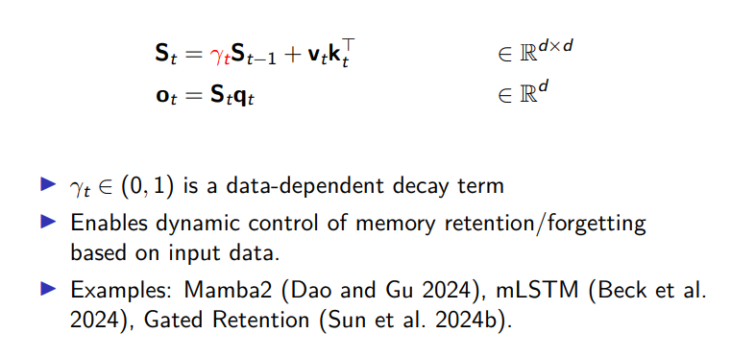
1.3 Challenges in Linear Attention: Instability
A simple fix: linear attention with data-dependent decay
Notes:
Previous decay is simple, and not sensitive to data itself. A further fix.

Slide 16
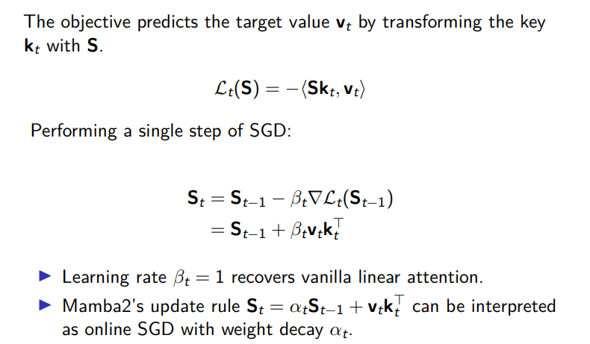
1.3 Challenges in Linear Attention
1.3 Challenges in Linear Attention: Poor Performance
A complicated fix: Linear attention optimizes a negative linear inner product loss via SGD
Notes:
The simple fix tried to solve the issue of lack of forgetting machenism, next we want to improve the performance, especially in the context retrieval capability. there’s another method called test-time training models.
first we change the view for understanding the memory, st, to see it as a updating rule for optimizing the loss function.
The objective function for this is actually an online learning objective function, and the hidden state updates are done via online gradient descent. Take DeltaNet, for instance. It updates the model parameters by optimizing a linear regression loss online. Through a single step of gradient descent, you then get the DeltaNet update formula. So, we look at the formula, it means we want to minimize the inner product of memory key, to its value vt.
Ppt lines…

Slide 17
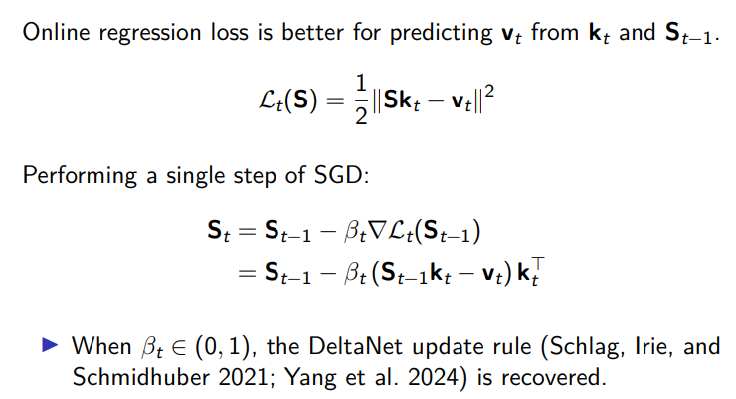
1.3 Challenges in Linear Attention
1.3 Challenges in Linear Attention: Poor Performance
A complicated fix: Linear attention optimizes a online regression loss via SGD
Notes:
And a better goal is to say, given a key, kt, we want to retrieve the information in memory S, so the value should be close to vt. Such will give out a deltarule of updating, which enhances the context retrievl ablity.

Slide 18
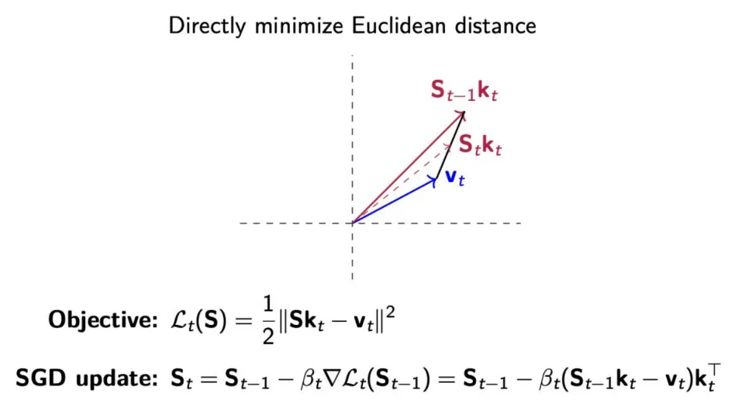
1.3 Challenges in Linear Attention: Poor Performance
A complicated fix: Linear attention optimizes a online regression loss via SGD
Notes:
This is a visualization for showing that the online regression loss via SGD. It is directly minimize the Euclidean , skt will gradually be close to vt. The model doesn't just "remember" the past; it actively trains on the past data token-by-token. It uses SGD (Stochastic Gradient Descent) to update its internal state (matrix $S$)

Slide 19
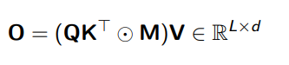
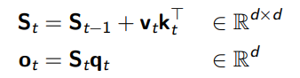
1.3 Challenges in Linear Attention: Engineering Optimization
Parallel Form:
Still quadratic in sequence length
Recurrent Form:
Sequential computation limits parallelization opportunities.
Poor GPU utilization due to lack of matrix-multiply operations (even with parallel scan algorithms)
Notes:
We have solve the equations of updating memory, s_t, One last issue, which is equaly important, when we look at the complexity, in parralel form, still quadratic for training, in recurrent form, is consrant for inference, but if we use it for training, we cannot utilisze the benefit of modern GPU, whichi is designed for matrix multiplication.

Slide 20
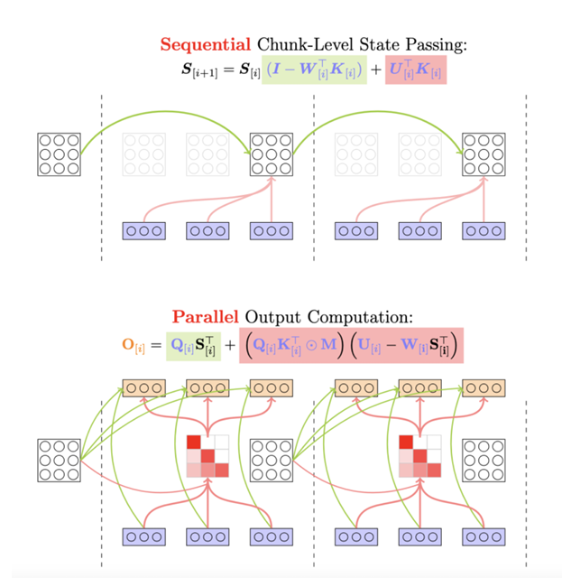
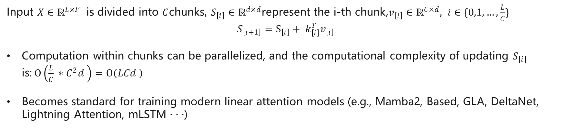
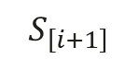
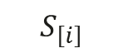
1.3 Challenges in Linear Attention: Engineering Optimization
Engineering Optimization of Linear Architecture: Chunk-wise parallelism
$$S_{\left[i\right]}$$
$$S_{\left[i+1\right]}$$
$$v_{\left[i\right]} k_{\left[i\right]}^{T}$$
Input $X∈ℝ^{L×F}$ is divided into $C$chunks, $S_{\left[i\right]}∈ℝ^{d×d}$represent the i-th chunk,$v_{\left[i\right]}∈ℝ^{C×d}, i∈\{0,1,…,\frac{L}{C}\}$
$$S_{\left[i+1\right]}=S_{\left[i\right]}+ k_{\left[i\right]}^{T}v_{\left[i\right]}$$
Computation within chunks can be parallelized, and the computational complexity of updating $S_{\left[i\right]}$ is:$O\left(\frac{L}{C} ∗C^{2}d \right)=O\left(LCd \right)$
Becomes standard for training modern linear attention models (e.g., Mamba2, Based, GLA, DeltaNet, Lightning Attention, mLSTM · · ·)
Notes:
So current linear attention models usually take the action of chunwise parallelism, with cuda or triton operations.
Within the chunks, we have the outer product that can be parallel, outside the chunk, we still need to update recurrent;ly.
The engineer view from hardware efficiency impose requirements of the above algorithm: structured matrix, allowing chunk-wise parallelism during training.
The linear models are not only algorithm design, but also have computational requirements & engineering design costs (chunk-wise parallelism; CUDA/Triton operators).

Slide 21
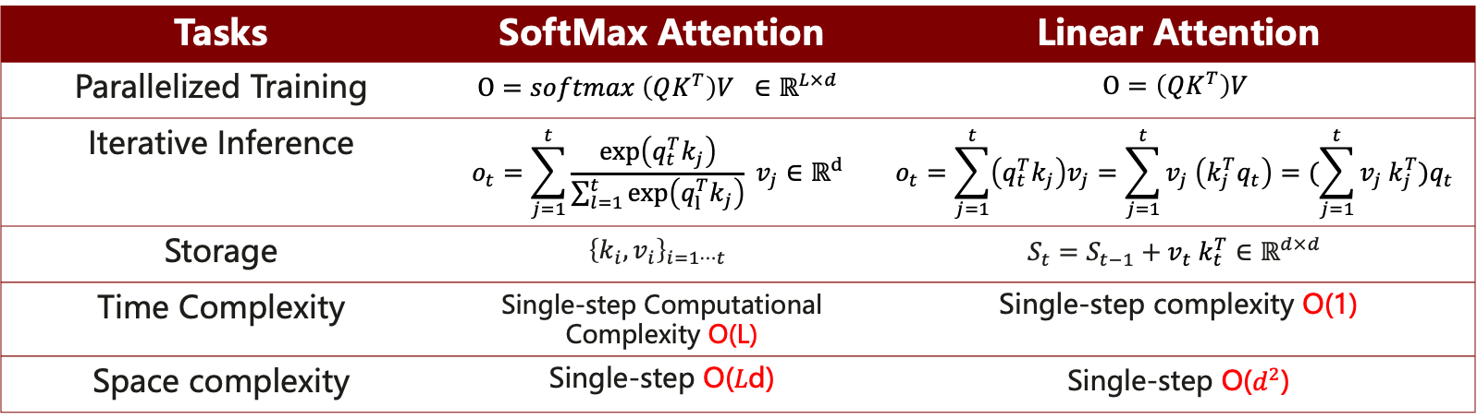
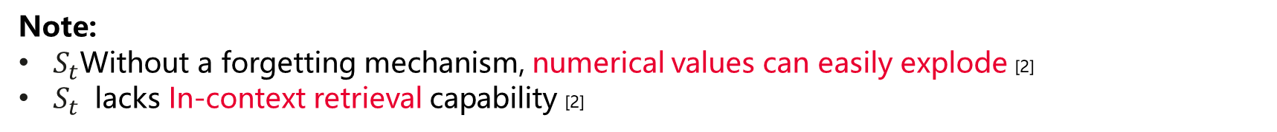
1.4 Summary
Tasks | SoftMax Attention | Linear Attention
Parallelized Training | $$O=softmax \left(QK^{T}\right)V ∈ℝ^{L×d}$$ | $$O=\left(QK^{T}\right)V$$
Iterative Inference | $$o_{t}=\sum_{j=1}^{t}{\frac{\exp\left(q_{t}^{T}k_{j}\right)}{\sum_{l=1}^{t}{\exp\left(q_{l}^{T}k_{j}\right)}}} v_{j}∈ℝ^{d}$$ | $$o_{t}=\sum_{j=1}^{t}{\left(q_{t}^{T}k_{j}\right)v_{j}=\sum_{j=1}^{t}{v_{j} \left(k_{j}^{T}q_{t}\right)=(\sum_{j=1}^{t}{v_{j} k_{j}^{T})q_{t}}}}$$
Storage | $${\left\{k_{i},v_{i}\right\}}_{i=1⋯t}$$ | $$S_{t}=S_{t−1}+v_{t} k_{t}^{T}∈ℝ^{d×d}$$
Time Complexity | Single-step Computational Complexity O(L) | Single-step complexity O(1)
Space complexity | Single-step O(𝐿d) | Single-step O($d^{2}$)
Note:
$S_{t}$Without a forgetting mechanism, numerical values can easily explode [2]
$S_{t}$ lacks In-context retrieval capability [2]
[1] : https://arxiv.org/abs/2210.10340
[2]: https://arxiv.org/abs/2406.06484s
Notes:
Removing softmax: This does not reduce complexity, but it gains convenient linearity, which allows for chunkwise optimization to speed up training.
Removing normalization: [1] has shown that removing the normalization term helps improve the training stability and task performance of linear attention. Currently, mainstream linear models have removed this normalization term.

Slide 22
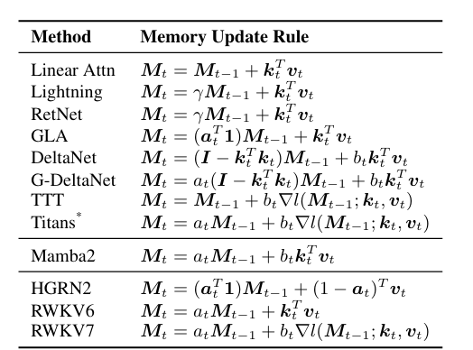
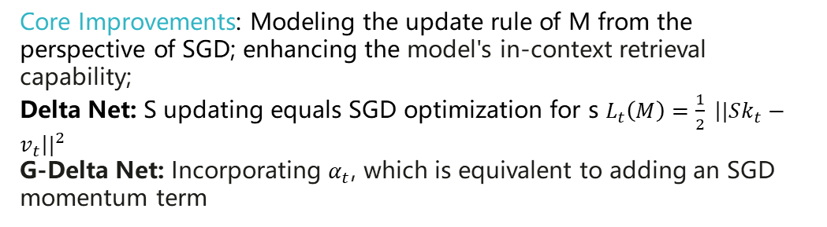
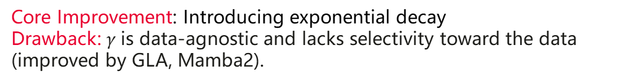
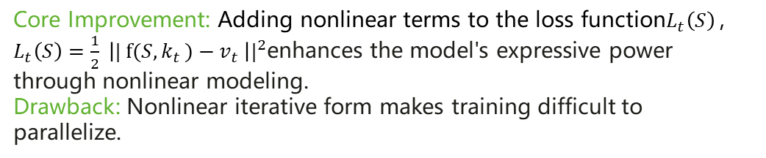
1.4 Comparison of Algorithms for Linear Attention
Core Improvement: Introducing exponential decay
Drawback: $γ$is data-agnostic and lacks selectivity toward the data (improved by GLA, Mamba2).
Core Improvements: Modeling the update rule of M from the perspective of SGD; enhancing the model's in-context retrieval capability;
Delta Net: S updating equals SGD optimization for s $L_{t}\left(M\right)=\frac{1}{2} {\left||Sk_{t}−v_{t}\right||}^{2}$
G-Delta Net: Incorporating $α_{t}$, which is equivalent to adding an SGD momentum term
Core Improvement: Adding nonlinear terms to the loss function$L_{t}\left(S\right)$, $L_{t}\left(S\right)=\frac{1}{2} {\left|| f(S{,k}_{t})−v_{t} \right||}^{2}$enhances the model's expressive power through nonlinear modeling.
Drawback: Nonlinear iterative form makes training difficult to parallelize.
MoM Table 1: Comparison of Different Linear Models. M is same as S in previous slides.
https://arxiv.org/abs/2502.13685
Notes:
Based on the vanilla linear attention, the table is drawn from other works so the notation is a bit different, M is equal to S in our previous slide, standing for the memory hidden state.
Ppt lines…

Slide 23
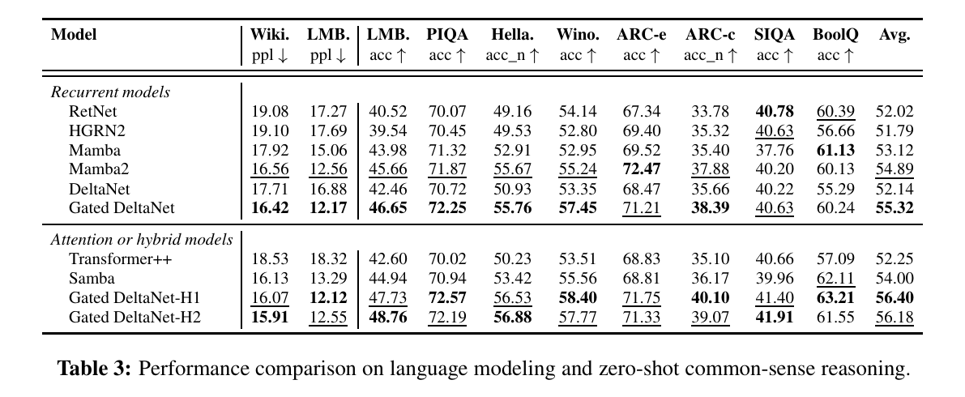
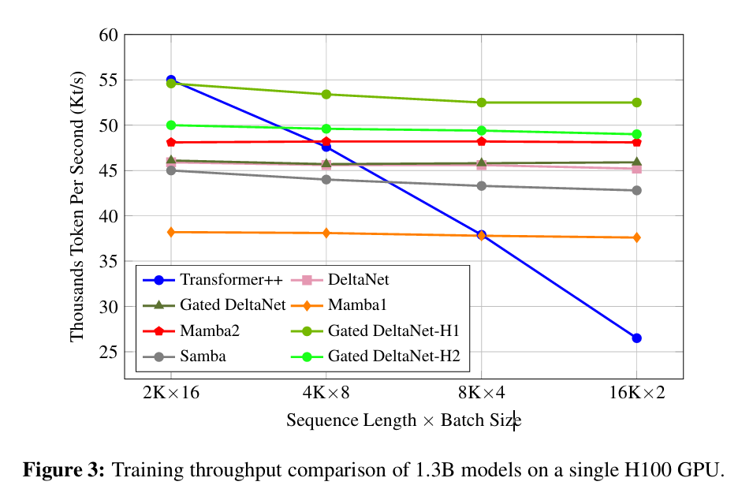
1.5 Experimental Result
ii. Training speed (+chunk-wise parallel training). As the sequence length increases, there is a 1–2x performance gain compared to Transformer.
i. Language task performance: Linear models can match the performance of Transformers on some tasks.
Source: Gated DeltaNet, https://arxiv.org/pdf/2412.06464
Notes:
After introducing , we look for the experimental result. We care about if linear models can compete with transformers, and the training speed, especillay on long sequences.
Ppt lines

Slide 24
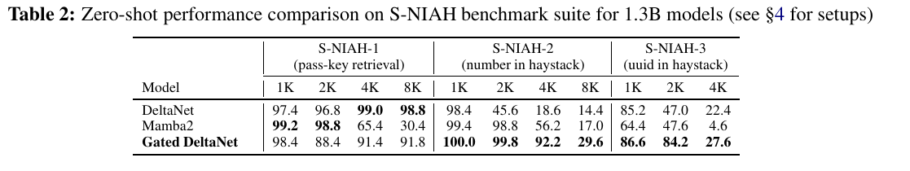
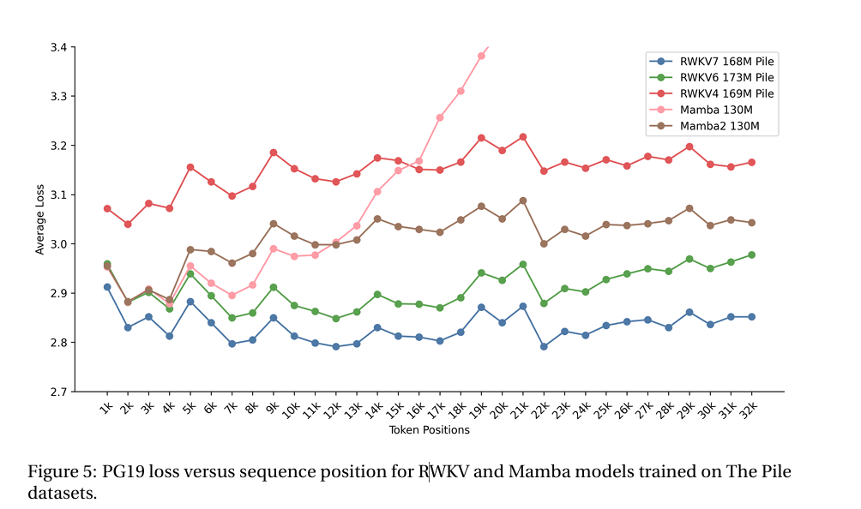
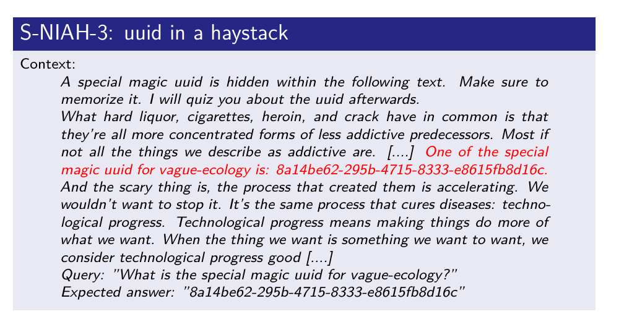
1.5 Experimental Result
iii. Stability of training on long sequences (+ decay): Token loss corresponding to sequence positions; linear models are not affected by position.
iv. Context retrieval performance (+ online learning): G-DeltaNet outperforms Mamba2 on long sequences.
Source: RWKV-7 https://arxiv.org/pdf/2503.14456
Source: Gated DeltaNet, https://arxiv.org/pdf/2412.06464
Notes:
We refeerd several terchniques to address the limitation of linear models, decay, chunkwise parallel, online learning by SGD. They are all useful parts.

Slide 25
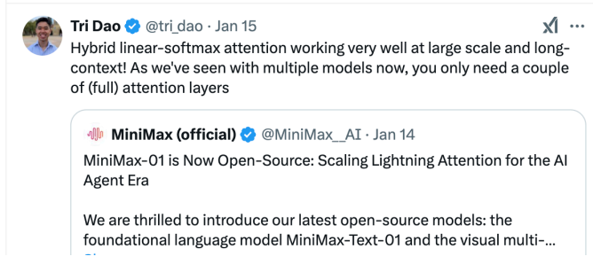
1.5 Experimental Result
v. Scaling law: Hybrid linear and softmax attention can achieve GPT-4o level performance
MiniMax-01 (MiniMax et al. 2025) used
Hybrid attention: 7/8 linear attention layers + 1/8 softmax attention layer
Lightning attention (Qin et al. 2024b): simple linear attention with data-independent decay
Notes:
Previous results are from academic paper, the model size is about 3 billion parameters, which is relative small.
And in industry, minimax has scale up to moe architechture, with 400billion parameters/

Slide 26
Outline – Efficient Attention Variants
Linear Attention Machenism
Data-dependent decay: RetNet, LighteningAttention, Mamba2, GLA
Test time online learning: DeltaNet, Test-Time-Training, Titans, RWKV7, Gated DeltaNet
Sparse Attention Mechanisms
Static Sparsity: BigBird, StreamingLLM, H2O
Dynamic Sparsity: Native Sparse Attention (DeepSeek), MoBA (Kimi)
Hybrid Attention Mechanisms
Inter-layer mixing: Minimax-01, Jamba, Samba
Intra-layer mixing: Hymba
Notes:
Then besides linear attention, there’s also something called sparse attention. Sparse attention is generally divided into static sparse and dynamic sparse. Static sparse means the sparse pattern is fixed beforehand—it doesn’t change during the calculation process. Some classic works on static sparse include BigBird, which is actually something Google did a while back. Then there’s StreamingLLM, which uses a sliding window plus the attention sink from the very beginning. Dynamic sparse is where the model dynamically changes the sparse pattern based on information at different positions. Recently, DeepSeek and Kimi have been pretty hot; they both released dynamic sparse mechanisms around the same time. One is Native Sparse Attention, and the other is MoBA.

Slide 27
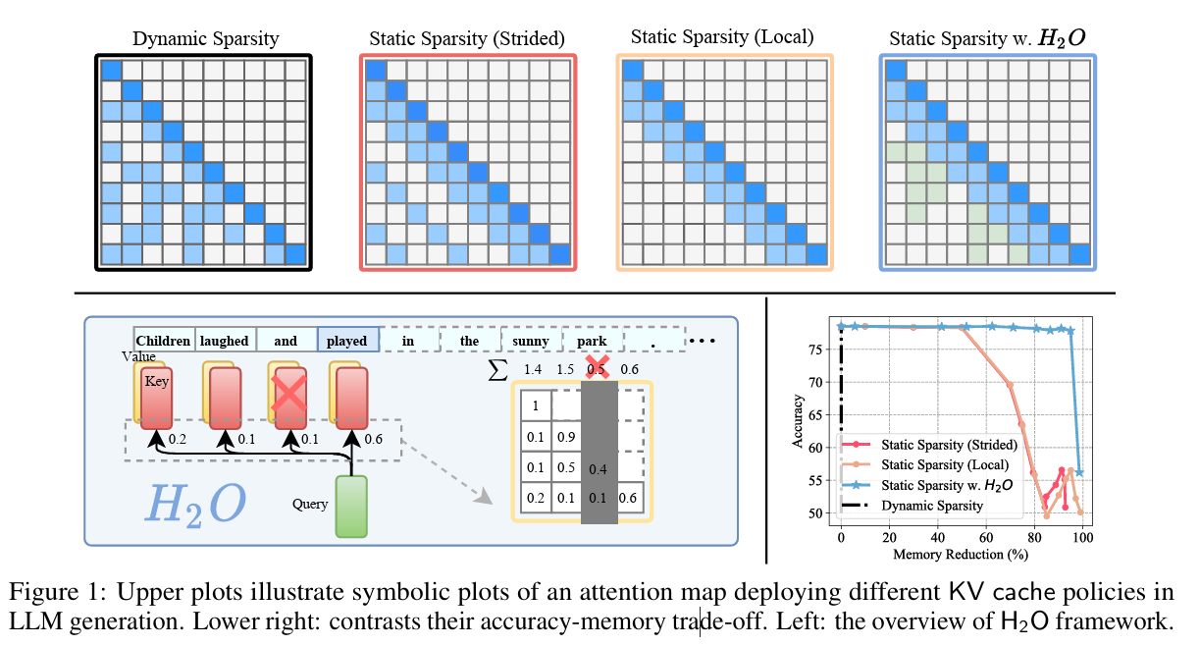
2. Sparse Attention Mechanisms: Static
Content-independent sparse patterns: BigBird, Window Attention, Streaming LLM, etc.
Content-dependent sparse patterns: H2O
Underlying structure of H2O
Widely used in the early stages of LLM research, they can simultaneously reduce computational complexity and the storage size of KV Cache.
Some information is permanently lost, which led to subsequent research on dynamic sparse attention.
H2O (NIPS23): https://arxiv.org/pdf/2306.14048
NSA (ACL25): https://arxiv.org/pdf/2502.11089
Notes:
For static sparse, the pattern is set beforehand, and it doesn't change with the input. Usually, because these methods have very strong priors, their expressive power is relatively weak. Nowadays, these methods aren't really used much anymore.

Slide 28
2. Sparse Attention Mechanisms: Dynamic
Dynamically determining the sparse pattern,
Challenge: How to maintain hardware efficiency?
Discontinuous sparsity cannot achieve the theoretical sparsity speedup ratio.
Common solution: Selecting the top k key/value blocks for different queries.
Reading each block continuously can better align with hardware.
Works: Native Sparse Attention (DeepSeek), MoBA (Kimi)
H2O (NIPS23): https://arxiv.org/pdf/2306.14048
NSA (ACL25): https://arxiv.org/pdf/2502.11089
Notes:
Dynamic sparse has been a pretty popular approach in recent years. Its main feature is that the sparse pattern is chosen dynamically by each individual token. The big challenge with dynamic sparse is that since the pattern is so flexible and doesn't follow a fixed rule, you can end up with non-continuous sparse patterns, and those tend to be slow on hardware. To tackle this, recent research has optimized things by making selections at the block level. Because a block usually contains multiple continuous tokens, the memory reads become continuous, which helps improve hardware efficiency.

Slide 29
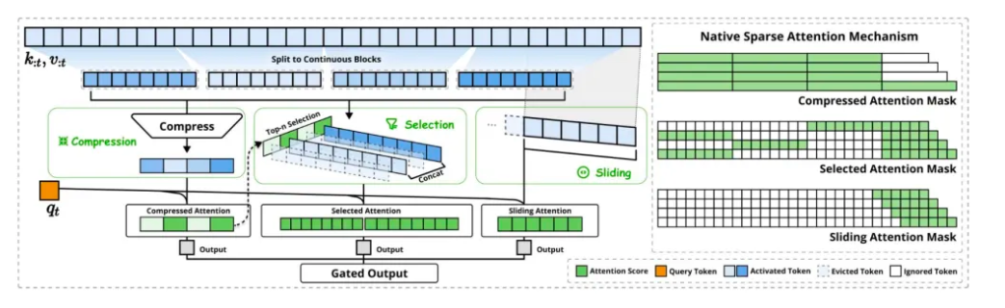
2. Sparse Attention Mechanisms: Dynamic (NSA)
Underlying structure of Native Sparse Attention (DeepSeek)
Three branches: compression, block selection, sliding window
Compression and block selection share attention scores; they can be pre-trained directly.
Key assumption: Each head under each query group selects the same KV block, which avoids different heads repeatedly reading different KV blocks, thereby reducing I/O overhead.
H2O (NIPS23): https://arxiv.org/pdf/2306.14048
NSA (ACL25): https://arxiv.org/pdf/2502.11089
Notes:
Next, I’ll briefly go over the idea behind Native Sparse Attention, which basically has three branches: compression, block selection, and sliding window. It divides the entire sequence into several chunks, and each chunk is first compressed into a single token representation via compression. Then, it uses the new orange query token to perform attention on these compressed tokens to get a compressed attention output. During this process, the attention scores are used to select the top-k attention blocks, and then sparse attention is executed on those specific blocks. Finally, a sliding window attention is added to supplement it. That’s the main approach of Native Sparse Attention.
The reason Native Sparse Attention is called "native" is that it can be used directly for pre-training, and it makes some assumptions, like every head under each query group selects the same KV block. This avoids different heads repeatedly reading different KV blocks, thereby reducing IO overhead.

Slide 30
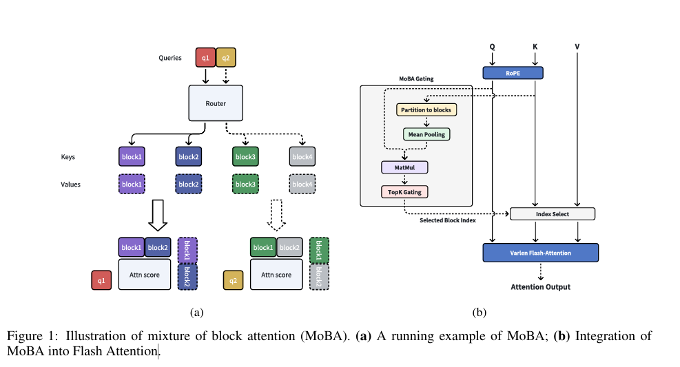
2. Sparse Attention Mechanism: Dynamic (MoBA)
Underlying Structure of MoBA (Kimi)
Minima design, no new parameters introduced (mean pooling), no forced selection of neighboring blocks.
Compatible with flash-attention kernel.
MoBA: https://arxiv.org/pdf/2502.13189
Notes:
The idea behind MoBA is actually very similar to Native Sparse Attention. For chunk pooling, it uses mean pooling. Unlike NSA, it doesn't have those multiple branches, so it doesn't introduce any extra parameters, and it doesn't force you to select adjacent blocks. It’s also relatively compatible with the Flash Attention kernel, but in terms of hardware training efficiency, it’s not quite as good as Native Sparse Attention
, with pre-training, MoBA can actually achieve performance that’s completely on par with full attention.

Slide 31
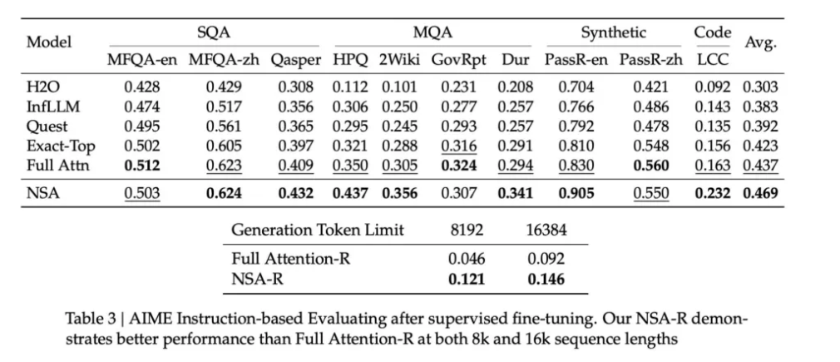
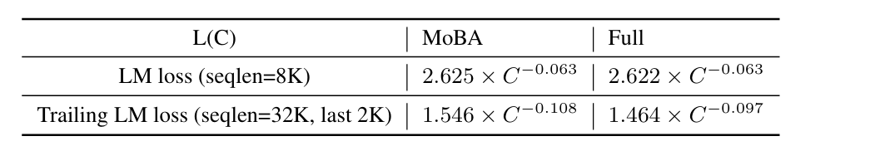
2. Sparse Attention Mechanism: Dynamic
Experimental results for NSA and MoBA,
NSA can even achieve better results than softmax attention;
MoBA performs similarly to softmax attention.
Notes:
One interesting finding is that Native Sparse Attention can actually outperform Global Attention on some tasks. Traditionally, people assumed that using sparse attention meant performance would drop—basically, that you could at best maintain the results, not improve them. But Native Sparse Attention, by learning its own attention distribution, is able to achieve results that are just as good as Global Attention. This suggests that by designing new architectures and pre-training them, we might actually get better results than we do with current architectures.

Slide 32
Outline – Efficient Attention Variants
Linear Attention Machenism
Data-dependent decay: RetNet, LighteningAttention, Mamba2, GLA
Test time online learning: DeltaNet, Test-Time-Training, Titans, RWKV7, Gated DeltaNet
Sparse Attention Mechanisms
Static Sparsity: BigBird, StreamingLLM, H2O
Dynamic Sparsity: Native Sparse Attention (DeepSeek), MoBA (Kimi)
Hybrid Attention Mechanisms
Inter-layer mixing: Minimax-01, Jamba, Samba
Intra-layer mixing: Hymba
Notes:
Inter-layer mixing means that different layers use different attention mechanisms; for example, some layers use Linear Attention, while others use Softmax Attention.
Intra-layer mixing, however, refers to using different mechanisms such as Sliding Window Attention and Linear Attention simultaneously within the same layer.

Slide 33
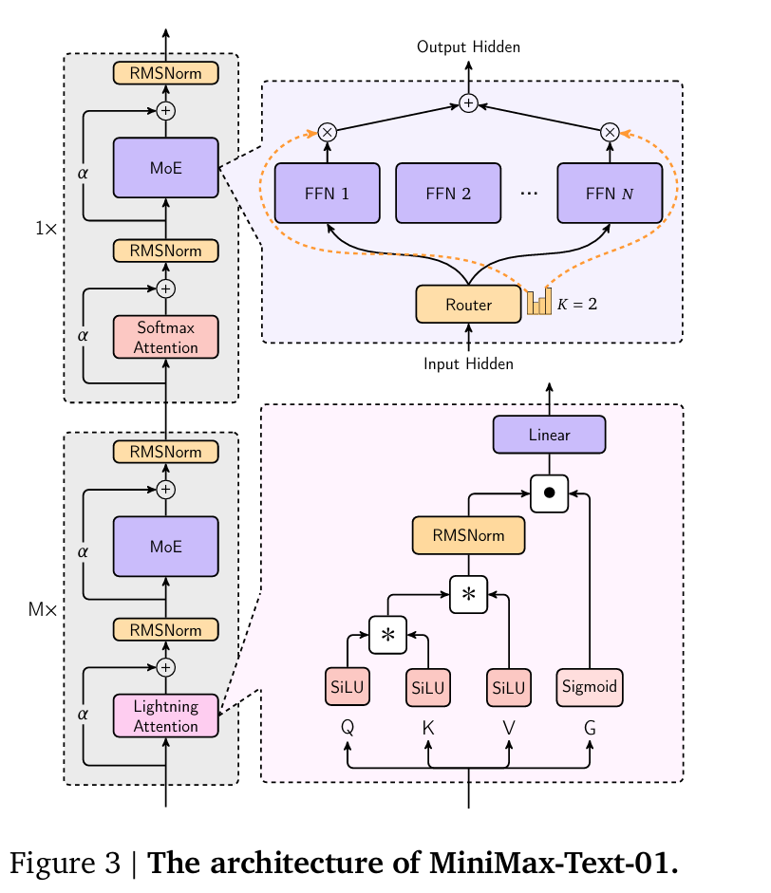
3. Mixed Attention Mechanism
Inter-layer mixing: different layers use different attention mechanisms
Example: Jamba, MiniMax-01 (MoE, 456B)
Mixing ratio: 7 linear attention : 1 softmax attention;
Since the KV cache for linear attention is negligible, it saves 7/8 of the KV cache across layers.
MiniMax01: https://arxiv.org/pdf/2501.08313
Titans: https://arxiv.org/pdf/2501.00663
Notes:
Earlier we mentioned that there are many hybrid methods. Basically, it just means using different mixing styles for different layers. Most layers use efficient attention mechanisms, and only a small number use global softmax attention.
For instance, usually we have seven-eighths of the layers using linear attention, and one-eighth using global softmax attention. The advantage of doing this is that we can directly save the KV cache for those seven-eighths of the layers. This is because the hidden state of linear attention can be expressed as an RNN, so its KV cache is essentially negligible.
Some typical examples of this are Jamba and MiniMax-01. Their approach is to use Lightning attention for a block of layers. As I mentioned earlier, Lightning attention is really just the simplest linear attention with an added decay term. Here,, creating a 7:1 ratio, which is quite common in practice.

Slide 34
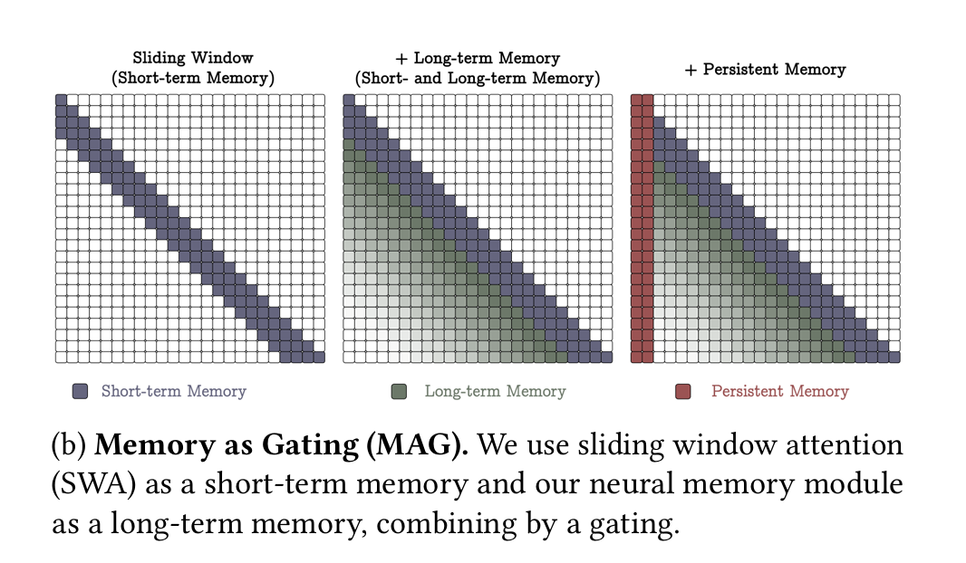
3. Mixed Attention Mechanism
Intra-layer mixing: A single layer can have both sparse attention and linear attention
Example: Hymba
Intra-layer mixing: MAG variant of Titans.
A single layer can have both sparse attention and linear attention
Sliding window attention: Short-term memory
Neural memory module: Long-term memory
MiniMax01: https://arxiv.org/pdf/2501.08313
Titans: https://arxiv.org/pdf/2501.00663
Notes:
By comparison, attention mixing methods are mainly about intra-layer mixing. Take Jamba, for instance; it’s a pretty typical example of this intra-layer mixing approach. Basically, it uses both sliding window attention and linear attention within the same layer. To be specific, it runs a sliding window attention first, and then adds a linear attention on top of that. This allows it to implement two different attention mechanisms right within that single layer.

Slide 35
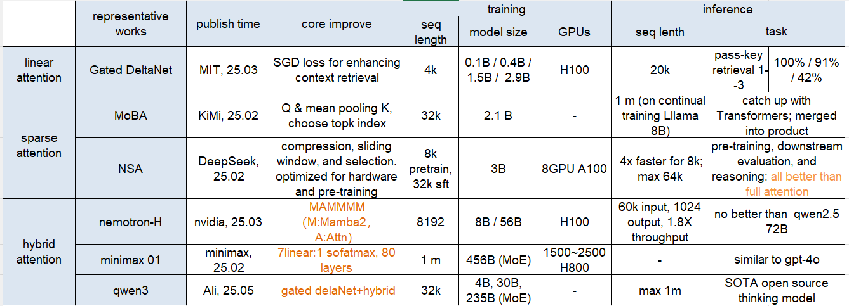
4. Summary of Efficient Attention Variants
Notes:
We have went through linear attention, sparse attention, hybrid attention, so here’s a summary for these works I meantion,
some representative works in this area. And we show the summarize of the academic and industry works based on these effective variants.

Slide 36
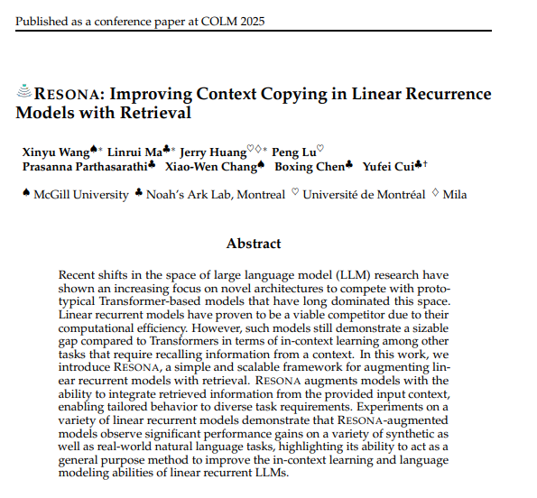
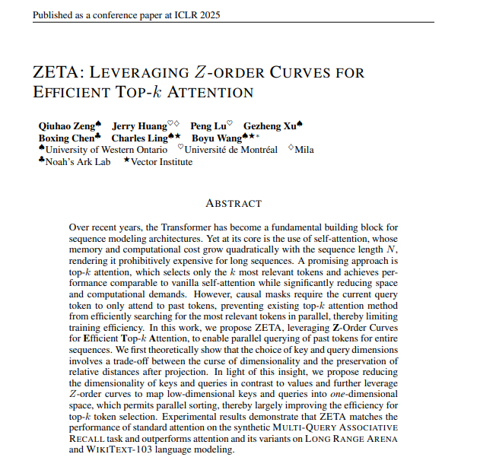
Openings (Intern & Full-time): zeng.wenqi@huawei.com
Related Works in Huawei
Notes:
Finnaly, in Huawei wo also has some works on the efficient architechtures, in sparse attention and hhybrid architechtures.
I am from The optimization and control group of the Theory Lab of 2012 Labs. Huawei Tech. is responsible for the optimization theory research and algorithm design.
Recently we are doing , applying mathematical, statistical, and machine learning techniques to solve problems from infrastructure and smart devices. And we are also designing effient llm archtechtures to speed up long context inference.
"We are currently recruiting for both internship and full-time positions. If you're interested, please email zeng.wenqi@huawei.com."

